Slide 1


Hamlyn Symposium on Medical Robotics 2021
Virtual Poster Submissions
Welcome to the Hamlyn Symposium on Medical Robotics 2021.
This year, we will be holding the symposium online. The key way in which you can get involved is to submit a virtual poster of your medical robotics research. If your poster is accepted into the symposium, it will be showcased online. In addition, a selection of submissions may be showcased during an online highlights session.
Please follow the steps below for creating a virtual poster:
Choose one of the templates in this document
Fill in the template with your poster content
Submit a PDF of your poster via our online form.
Key points
The poster should be under 10MB in size.
The poster should be A4.
The main bodies of text within the poster should be black on a white background.
The font should be Calibri.
All text should be 6pt or larger.
In the top left hand corner of the poster you should include a square thumbnail image that is representative of your work.
In the top right hand corner, please include the Hamlyn Symposium 2021 logo.
To make your poster unique, you can use a suitable background image under the white text boxes.
If you have any questions, please contact Marianne Knight.

Slide 2

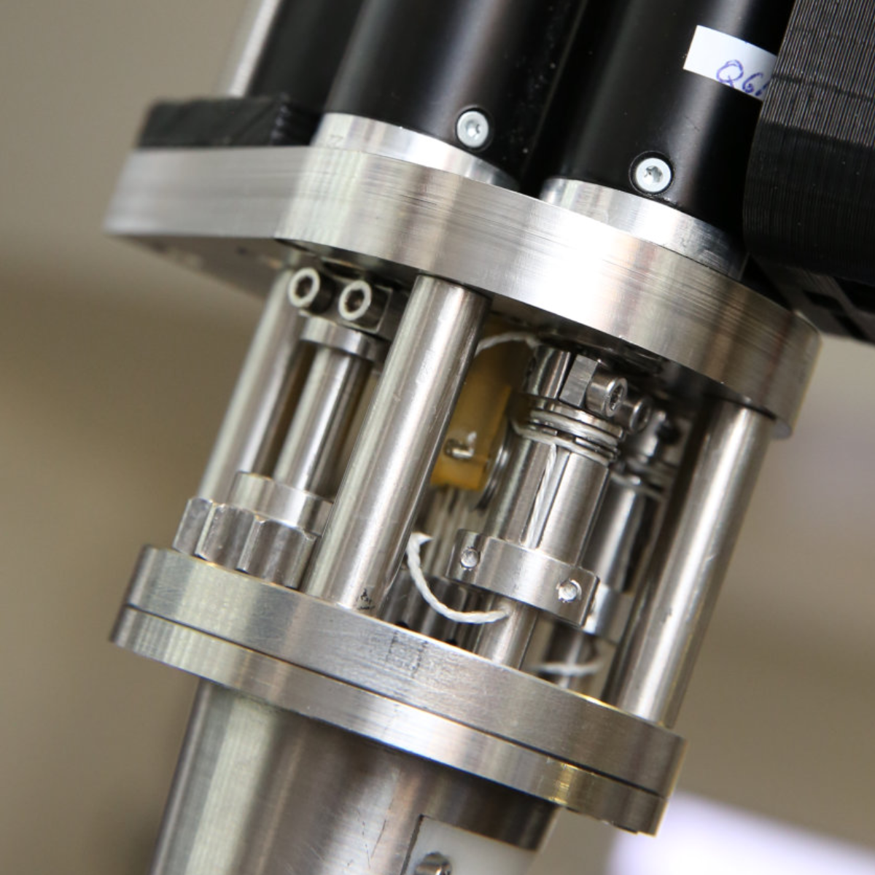
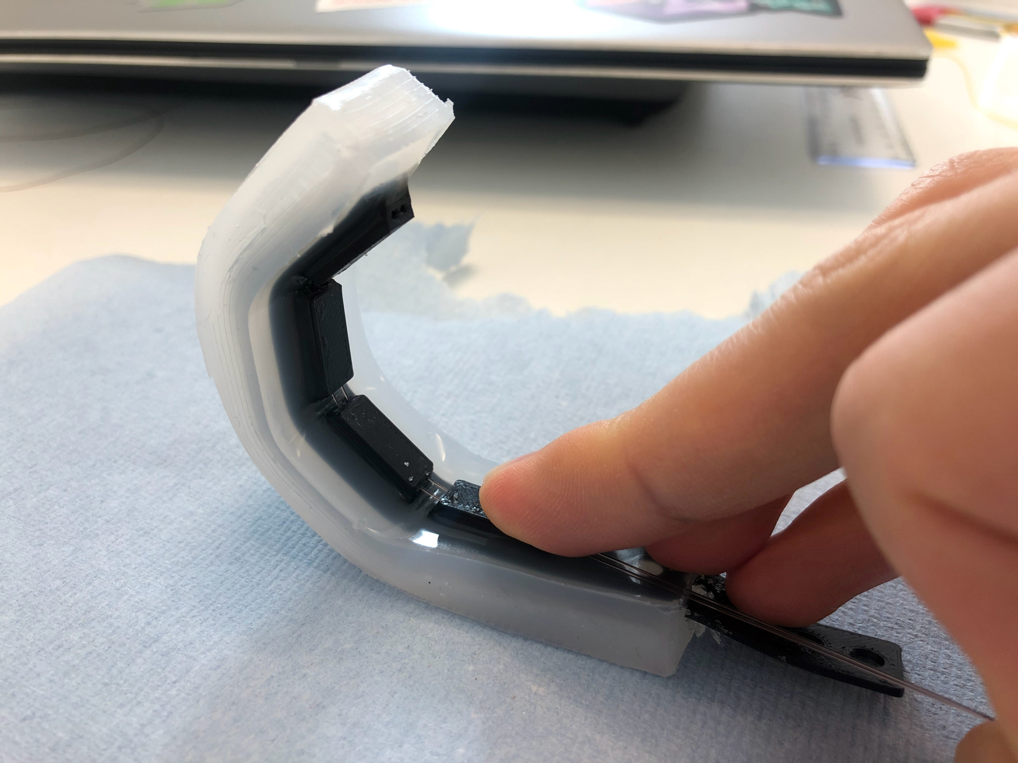

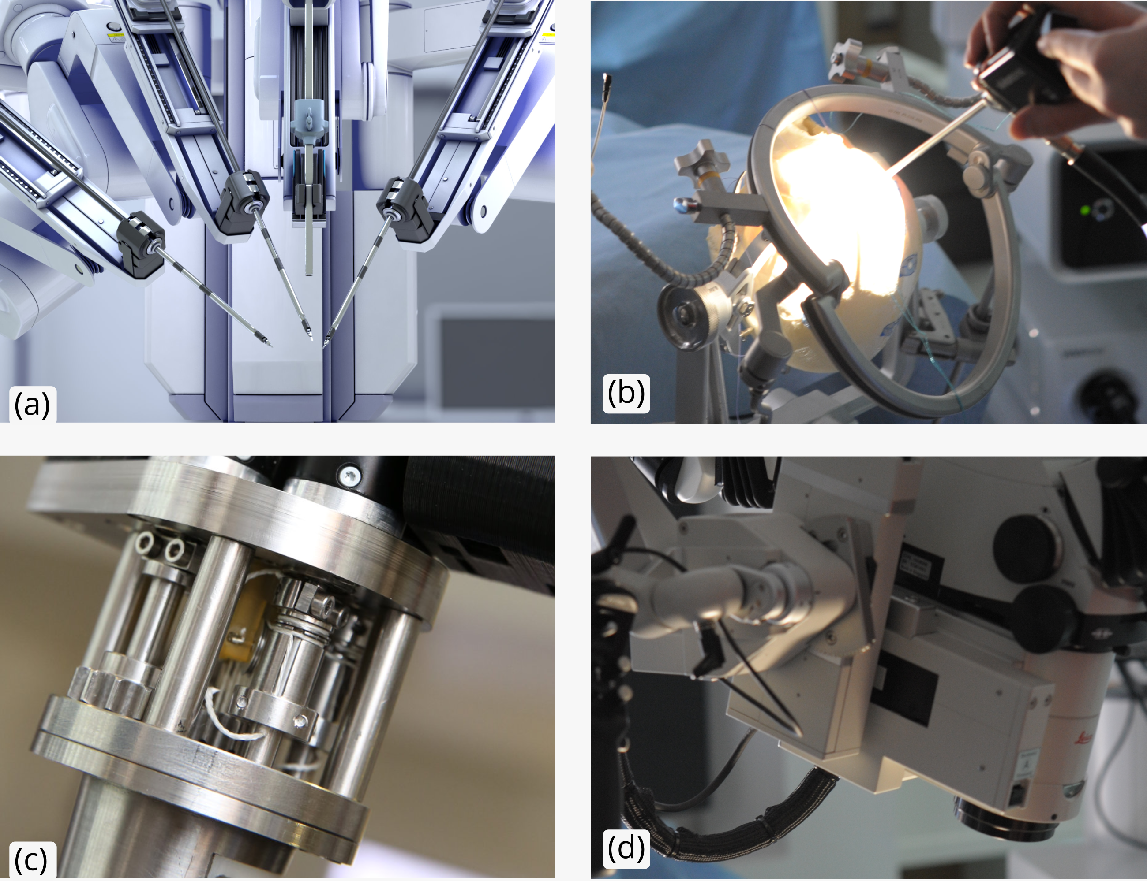
Sensing Soft Robot Actuation with Electrical Impedance Tomography (EIT)
Charles DeLorey [charles dot delorey 20 at imperial dot ac dot uk]
The Hamlyn Centre, Institute of Global Health Innovation, Imperial College London, United Kingdom
Introduction
Soft robots are notoriously difficult to characterize due to their lack of rigid joints and precise end effector control. Sensing methods are developed to solve this problem. Electrical Impedance Tomography (EIT) is an imaging method which has a variety of applications from geophysical observation to lung monitoring. This project leverages EIT to produce low cost and accurate shape change in a soft robot actuator.
incididunt. Tempor, qui, tempor ea voluptate, enim labore sed velit minim tempor do enim. Ut officia ipsum aliquip dolore ex eiusmod ut eiusmod eu consequat, do, exercitation elit ut sint cupidatat. Esse, in duis eiusmod ea pariatur ad. Exercitation aliquip incididunt non fugiat ut in ipsum dolor, pariatur in irure exercitation, ullamco qui incididunt ullamco dolor et. Dolore exercitation est ut incididunt.
Method
The EIT actuator is comprised of two parts: The interior flexible “bone” piece and the silicone EIT chamber.
Esse, in duis eiusmod ea pariatur ad. Exercitation aliquip incididunt non fugiat ut in ipsum dolor, pariatur in irure exercitation, ullamco qui incididunt ullamco dolor et. Dolore exercitation est ut incididunt. Tempor, qui, tempor ea voluptate, enim labore sed velit minim tempor do enim. Ut officia ipsum aliquip dolore ex eiusmod ut eiusmod eu consequat, do, exercitation elit ut sint cupidatat. Esse, in duis eiusmod ea pariatur ad. Exercitation aliquip incididunt non fugiat ut in ipsum dolor, pariatur in irure exercitation, ullamco qui incididunt ullamco dolor et. Dolore exercitation est ut incididunt. Tempor, qui, tempor ea voluptate, enim labore sed velit minim tempor do enim. Ut officia ipsum aliquip dolore ex eiusmod ut eiusmod eu consequat, do, exercitation elit ut sint cupidatat. Esse, in duis eiusmod ea pariatur ad. Exercitation aliquip incididunt non fugiat ut in ipsum dolor, pariatur in irure exercitation, ullamco qui incididunt ullamco dolor et. Dolore exercitation est ut incididunt.
Results
In duis eiusmod ea pariatur ad. Exercitation aliquip incididunt non fugiat ut in ipsum dolor, pariatur in irure exercitation, ullamco qui incididunt ullamco dolor et. Dolore exercitation est ut incididunt. Tempor, qui, tempor ea voluptate, enim labore sed velit minim tempor do enim. Ut officia ipsum aliquip dolore ex eiusmod ut eiusmod eu consequat, do, exercitation elit ut sint cupidatat. Esse, in duis eiusmod ea pariatur ad. Exercitation aliquip incididunt non fugiat ut in ipsum dolor, pariatur in irure exercitation, ullamco qui incididunt ullamco dolor et. Dolore exercitation est ut incididunt. Tempor, qui, tempor ea voluptate, enim labore sed velit minim tempor do enim. Ut officia ipsum aliquip dolore ex eiusmod ut eiusmod eu consequat, do, exercitation elit ut sint cupidatat. Esse, in duis eiusmod ea pariatur ad. Exercitation aliquip incididunt non fugiat ut in ipsum dolor, pariatur in irure exercitation, ullamco qui incididunt ullamco dolor et. Dolore exercitation est ut incididunt.
Discussion and Future Work
In duis eiusmod ea pariatur ad. Exercitation aliquip incididunt non fugiat ut in ipsum dolor, pariatur in irure exercitation, ullamco qui incididunt ullamco dolor et. Dolore exercitation est ut incididunt. Tempor, qui, tempor ea voluptate, enim labore sed velit minim tempor do enim. Ut officia ipsum aliquip dolore ex eiusmod ut eiusmod eu consequat, do, exercitation elit ut sint cupidatat. Esse, in duis eiusmod ea pariatur ad. Exercitation aliquip incididunt non fugiat ut in ipsum dolor, pariatur in irure exercitation, ullamco qui incididunt ullamco dolor et. Dolore exercitation est ut incididunt. Tempor, qui, tempor ea voluptate, enim labore sed velit minim tempor do enim. Ut officia ipsum aliquip dolore ex eiusmod ut eiusmod eu consequat, do, exercitation elit ut sint cupidatat. Esse, in duis eiusmod ea pariatur ad. Exercitation aliquip incididunt non fugiat ut in ipsum dolor, pariatur in irure exercitation, ullamco qui incididunt ullamco dolor et. Dolore exercitation est ut incididunt.
In duis eiusmod ea pariatur ad. Exercitation aliquip incididunt non fugiat ut in ipsum dolor, pariatur in irure exercitation, ullamco qui incididunt ullamco dolor et. Dolore exercitation est ut incididunt. Tempor, qui, tempor ea voluptate, enim labore sed velit minim tempor do enim. Ut officia ipsum aliquip dolore ex eiusmod ut eiusmod eu consequat, do, exercitation elit ut sint cupidatat. Esse, in duis eiusmod ea pariatur ad.
Figure 1 - (a) In duis eiusmod ea pariatur ad; (b) In duis eiusmod ea pariatur ad; (c) In duis eiusmod ea pariatur ad; (d) ea pariatur ad. Exercitation aliquip incididunt non fugiat ut in ipsum dolor, pariatur in irure exercitation, ullamco.
References
[1] Author, A. & Author, B. (2020) Title. Journal. 451 (7177), 397-399. Available from: http://www.journal.com/451397a.html [Accessed 20 January 2020].
[2] Author, A. & Author, B. (2020) Title. Journal. 451 (7177), 397-399. Available from: doi:10.1016/j.applthermaleng.2020.06.011
[3] Author, A. & Author, B. (2020) Title. Journal. 451 (7177), 397-399. Available from: http://www.journal.com/451397a.html [Accessed 20 January 2020].
Ethics, grant, acknowledgement and open access information.

